Slide 1

CMPP 257
Introduction to JavaScript & JQuery
Module 3: Loop Statements & Arrays
Dr. Hamdy Ibrahim
CMPP 257: Introduction to JavaScript & JQuery

Slide 2
Outlines
Loop
  Concepts
  Loop statements: for, while, and do-while
Array
  Declaration & Initialization
  Array Processing
CMPP 257: Introduction to JavaScript & JQuery

Slide 3

Loop
Loop
Iterative/Repetition → Reducing LOC
Conditionally Executing Block of Code Multiple Times
Each Single Execution Path → Iteration
Has a Body, Condition, Control Variable
Examples
Calculating GPA for 100 Students (100 iterations)
GPA Calculation is Repeated 100 Times
Adding 4 Items to Purchasing Cart
CMPP 257: Introduction to JavaScript & JQuery

Slide 4

Loop: Types & How It Works?
Set Control variable to an initial value (e.g. 1)
Start the loop
If the specified condition is true:
{
Do some stuff.
Update the control variable
Go back to line 3 and
start again.
}
If the condition is no longer true, go to the next line.
Start
Initialize Control Variable
False
Condition?
True
Pre-Test Loop: Condition is Tested First
Continually Repeat Instructions Until a Certain Condition is Reached.
Loop Body
(Updating CV)
END
CMPP 257: Introduction to JavaScript & JQuery

Slide 5
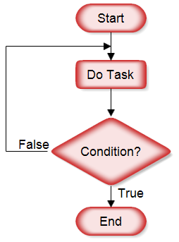
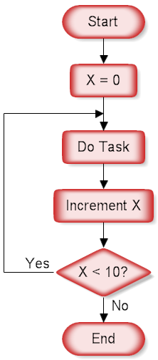

Loop/Repetition Types
Post-Test Loop: Loop Body is Executed at Least Once before Testing the Condition
CMPP 257: Introduction to JavaScript & JQuery

Slide 6


Avoid Infinite Loop
Start
Read num1
Infinite Loop: Loop Never Terminate
num2 = num1 + 1
Display “Hello”
Caused by Invalid Conditions
Caused by Failing to Update the Control Variable Properly
True
num1 < num2?
False
END
CMPP 257: Introduction to JavaScript & JQuery

Slide 7
Avoid Infinite Loop
Declare a string variable, name
Ask the user: "Enter your friend's name:“
Store the entry in name
Start/Repeat the loop: if name != "done"
{
Display name
Ask the user: "Enter your friend's name:"
Store the entry in name
Check the condition
}
Display “The End”
For How Many Iterations the Loop Body will be Executed? Why?
CMPP 257: Introduction to JavaScript & JQuery

Slide 8
FOR Statement
for :Pre-Test
for(Initialization; Conditions; Update) { Statements}
for (var i=0; i<24; i++) { alert(“Hello Class”);}
Initialization
Condition
Update
For How Many Times, Hello Class will be Displayed?
CMPP 257: Introduction to JavaScript & JQuery

Slide 9
FOR Statement
for (var i = 0; i < 3; i++) {
document.write(i);
}
Term | Example
for | Keyword
Initialization | var i = 0;
Control Variable | i
Condition | i < 3;
Update Control Variable | i++;
Loop Body | Document.write(i);
No. of Iterations | 3
The Control Variable can be Used within the Loop Body
CMPP 257: Introduction to JavaScript & JQuery

Slide 10
FOR Statement
for (var i = 0; i < 3; i++) {
document.write(i);
}
Iteration | Steps | Iteration | Steps
1 | i = 0 | 2 | i = 1
 | Is i < 3? |  | Is i < 3?
 | Yes, write i to the page |  | Yes, write i to the page
 | Increment i |  | Increment I
3 | i = 2 | 4 | i = 3
 | Is i < 3? |  | Is i < 3?
 | Yes, write i to the page |  | No, Terminate The Loop
 | Increment I |  | Increment I
CMPP 257: Introduction to JavaScript & JQuery

Slide 11
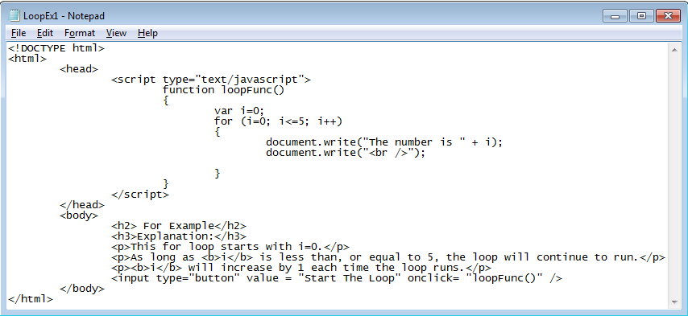
FOR Statement
CMPP 257: Introduction to JavaScript & JQuery

Slide 12
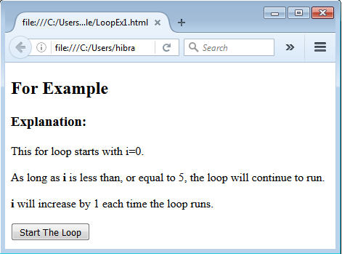
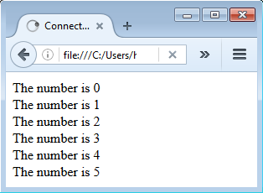
FOR Statement
Clicked
CMPP 257: Introduction to JavaScript & JQuery

Slide 13
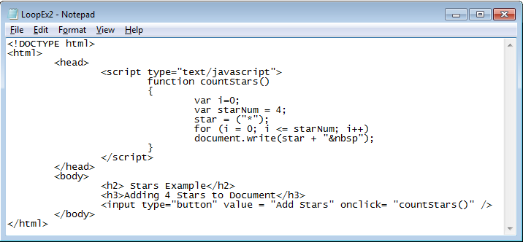
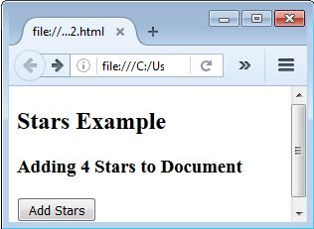
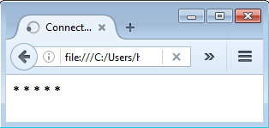
FOR Statement
{} is Option if There is Only One Sentence
CMPP 257: Introduction to JavaScript & JQuery

Slide 14
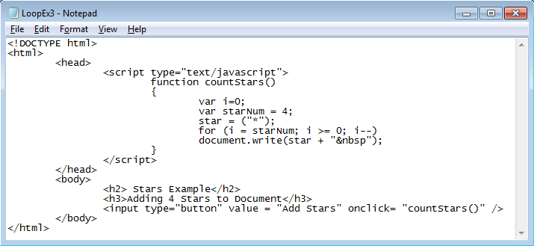
FOR Statement
i is initially set to 4
CMPP 257: Introduction to JavaScript & JQuery

Slide 15
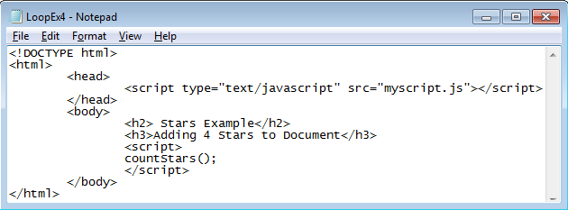
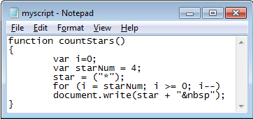
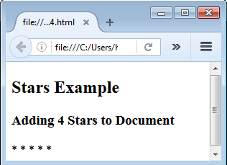
FOR Statement
Using External File
CMPP 257: Introduction to JavaScript & JQuery

Slide 16
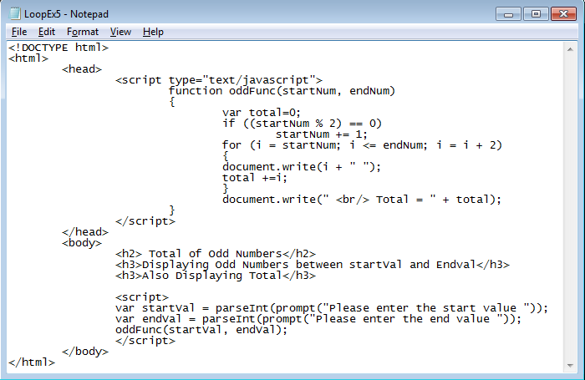
FOR Statement
Task 1: Trace the Script Execution and Identify the Functionality
Modify the Code to Display Even Numbers and Its Total
CMPP 257: Introduction to JavaScript & JQuery

Slide 17
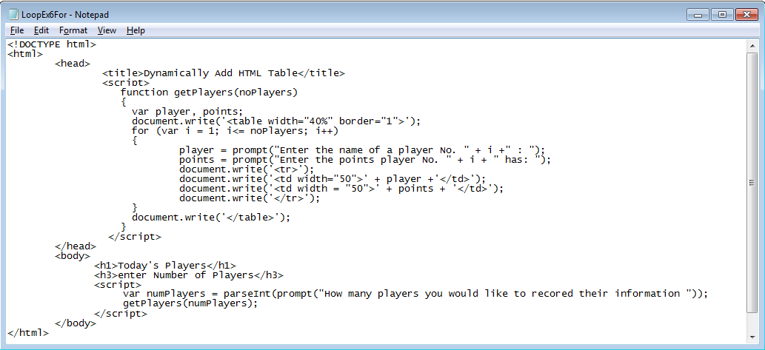
FOR Statement
Task 2: Trace the Script Execution and Identify the Functionality.
CMPP 257: Introduction to JavaScript & JQuery

Slide 18
WHILE Statement
while: Pre-Test
while(Conditions) { Statements }
var i=0;
while (i<24)
{
alert(“Hello Class”);
i++;
}
Initialization
Condition
Update
For How Many Times, Hello Class will be Displayed?
CMPP 257: Introduction to JavaScript & JQuery

Slide 19
WHILE Statement
var i = 0;
while (i < 3)
{
document.write(i);
i++;
}
Term | Example
While | Keyword
Initialization | var i = 0;
Control Variable | i
Condition | i < 3;
Update Control Variable | i++;
Loop Body | Document.write(i);
No. of Iterations | 3
The Control Variable can be Used within the Loop Body
CMPP 257: Introduction to JavaScript & JQuery

Slide 20
WHILE Statement
while: Pre-Test
Recommended If No. of Iterations is Unknown
During Script Execution, User Decides The Loop Termination
var i = 0;
var response = “yes“;
while (response == “yes”)
{ document.write(i + “ “);
response = prompt(“Please Enter yes to continue and no to end”);
i++;
}
CMPP 257: Introduction to JavaScript & JQuery

Slide 21
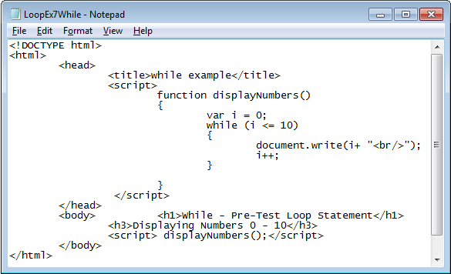
WHILE Statement
Task 3: Trace the Script Execution and Identify the Functionality
Modify the Code to Display Odd Numbers and Its Total
CMPP 257: Introduction to JavaScript & JQuery

Slide 22
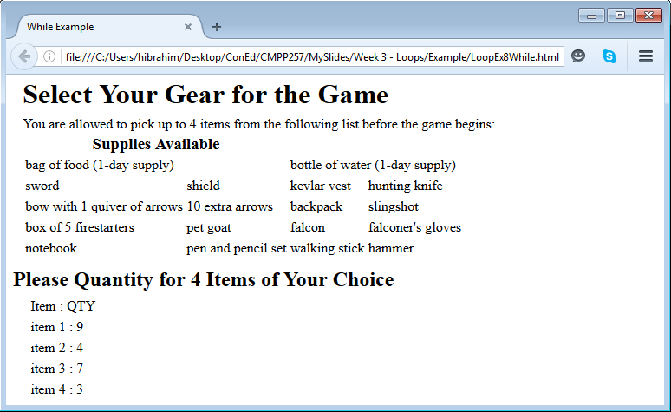
WHILE Statement
Initially Displayed
Displayed After Getting QTYs from the User
Task 4: Create the above page. Include a script that enable the user to enter QTY for 4 Items and display these QTYs
CMPP 257: Introduction to JavaScript & JQuery

Slide 23

DO-WHILE Statement
do-while: Post-Test
do { Statements } while(Conditions);
var i=0;
do
{
alert(“Hello Class”);
i++;
} while (i < 24);
Initialization
The Loop will be Executed at Least Once before Testing the Condition
Update
Condition
CMPP 257: Introduction to JavaScript & JQuery

Slide 24
DO-WHILE Statement
var i = 0;
do
{
document.write(i);
i++;
} while (i < 3);
Term | Example
While | Keyword
Initialization | var i = 0;
Control Variable | i
Condition | i < 3;
Update Control Variable | i++;
Loop Body | Document.write(i);
No. of Iterations | 3
The Control Variable can be Used within the Loop Body
CMPP 257: Introduction to JavaScript & JQuery

Slide 25
DO-WHILE Statement
<html> <head>
<title>Payroll</title>
<script>
function getPay() {
document.write('<table width="40%" align = "center">');
var name = " "; var hours = 0; var rate = 0; var grossPay = 0; var netPay = 0;
document.write('<tr><td>name</td><td>gross pay</td><td>net pay</td></tr>');
name = prompt("Enter the first employee's name:");
do {
hours = parseFloat(prompt("How many hours did " + name + " work this week?"));
rate = parseFloat(prompt("What is " + name + "'s hourly pay rate?"));
if (hours > 40)
grossPay = (40 * rate) + ((hours - 40) * 1.5 * rate);
else
grossPay = hours * rate; netPay = grossPay * .85;
document.write('<tr><td>' + name + '</td><td>$ ' + grossPay + '</td><td>$ ' + netPay + '</td></tr>');
name = prompt("Enter another employee's name or enter 'done' when finished:");
} while (name != "done")
document.write('</table>');
}
</script> </head>
<body>
<h1>Calculate Employees Paychecks</h1>
<p>You can enter payroll information for all employees. Paychecks are calculated as shown:</p>
<p>OUTPUT GOES HERE</p>
<p><input type="button" id="pay" value="Click to begin entering employees" onclick="getPay();" /></p>
</body> </html>
CMPP 257: Introduction to JavaScript & JQuery

Slide 26
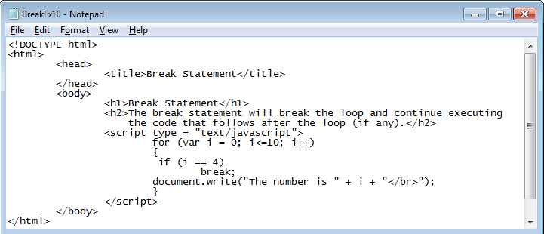

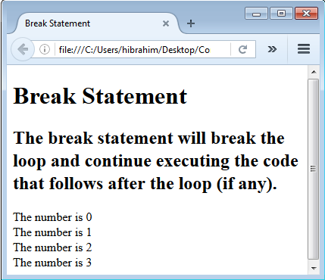
break & continue
break statement
CMPP 257: Introduction to JavaScript & JQuery

Slide 27
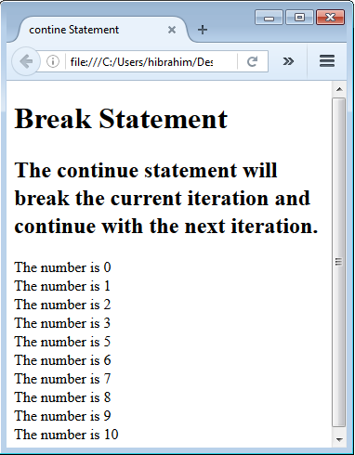
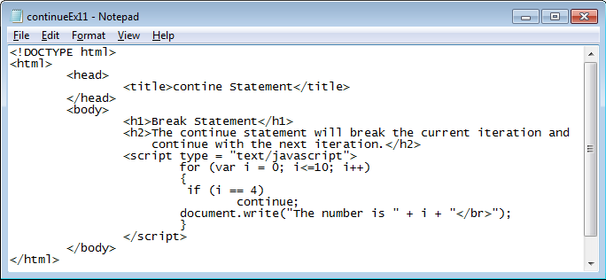

break & continue
continue statement
CMPP 257: Introduction to JavaScript & JQuery

Slide 28
Arrays
Array
Collection of Data Items: Non-Primitive
Dynamic: Size is Changeable
Array Elements: Group of Memory Locations
Same Name and Different Data Type – Different Index
CMPP 257: Introduction to JavaScript & JQuery

Slide 29
Arrays
C[0] | -45
C[1] | 6
C[2] | 0
C[3] | 72
C[4] | 14
C[5] | 35
C[6] | -98
C[7] | 26
C[8] | -1
C[9] | 4896
1st Element : C[0]
Last Element : C[9]
Position Number of the Element within the Array C
Name of Individual Element
Value
Referencing Element : C[index]
If the Array has i-Elements, Last Index = i - 1
Name of the Array is C with 10 Elements
CMPP 257: Introduction to JavaScript & JQuery

Slide 30


Arrays
Array
Follow Same Naming Rules of Variables
Array is Object → Attributes and Methods
arrayName.length → Array Size
Methods: toString(), sort(), reverse()
Why Arrays?
It can be used to reduce # of variable names
It can be used to create more efficient programs
CMPP 257: Introduction to JavaScript & JQuery

Slide 31

Creating Arrays
Creation
1. var array_name = [Value1, Value2, ….];
var courseCode = [“CMPN215”, “CMPP257”,…];
var person = [“John, “Doe”, 46];
2. var arrayName = new Array(V1, V2, …);
var courseCode = new Array(“CMPN215”, “CMPP257”,…);
CMPP 257: Introduction to JavaScript & JQuery

Slide 32
Creating Arrays
Creation
3. var array_name = new Array (No_Of_Elements);
var players = new Array(50); // Not Initialized
4. var array_name = new Array ();
var players = new Array(); // Size is not specified
CMPP 257: Introduction to JavaScript & JQuery

Slide 33
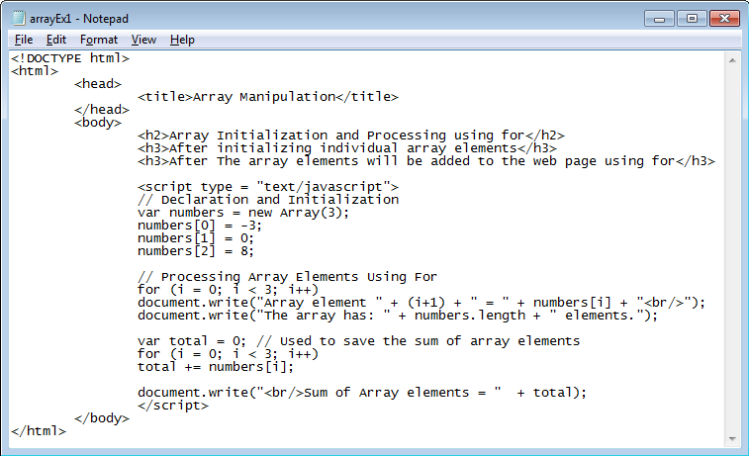
Processing Arrays
CMPP 257: Introduction to JavaScript & JQuery

Slide 34
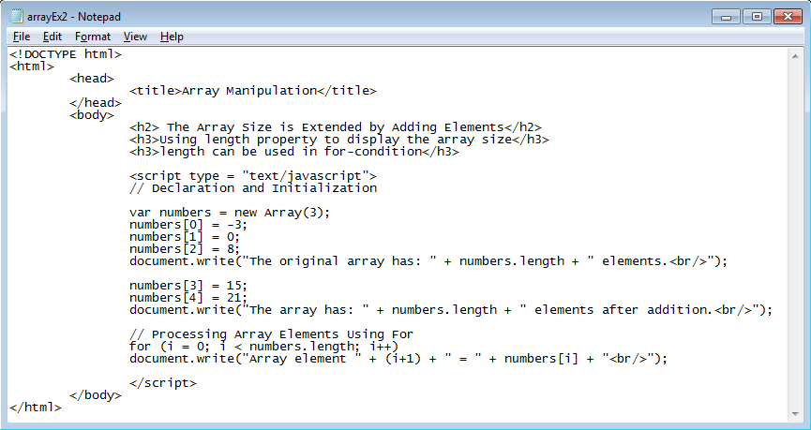
Processing Arrays
CMPP 257: Introduction to JavaScript & JQuery

Slide 35
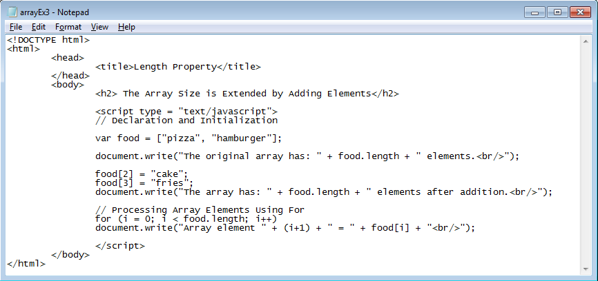
Processing Arrays
CMPP 257: Introduction to JavaScript & JQuery

Slide 36
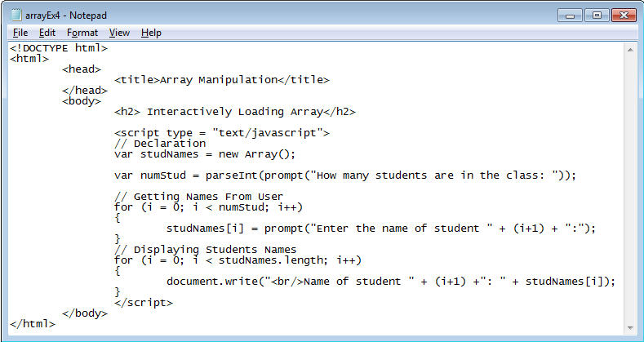
Loading Array Interactively
CMPP 257: Introduction to JavaScript & JQuery

Slide 37
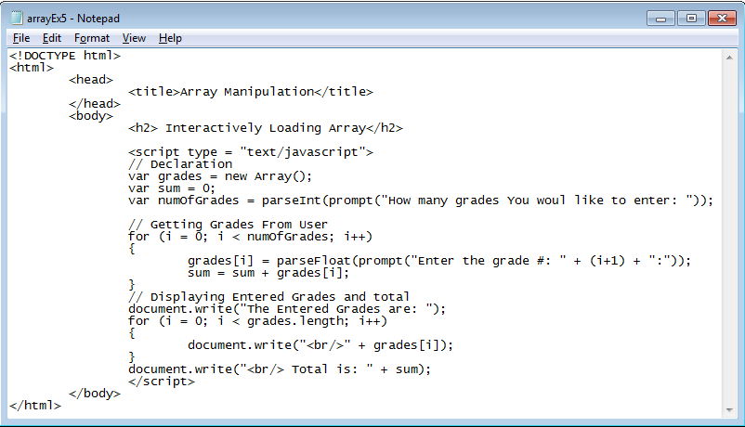
Loading Array Interactively
CMPP 257: Introduction to JavaScript & JQuery

Slide 38
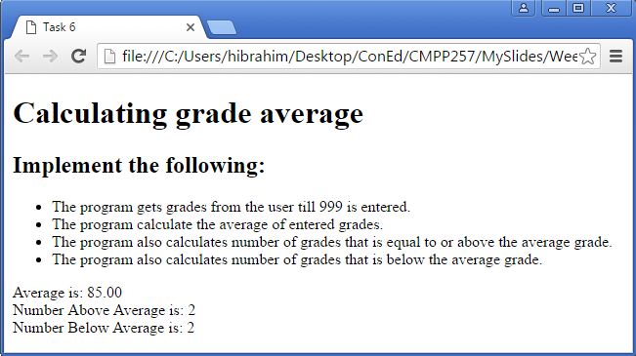
Tasks
Task 5: Re-implement the functionality in slide 25 using arrays
Task 6
CMPP 257: Introduction to JavaScript & JQuery

Slide 39
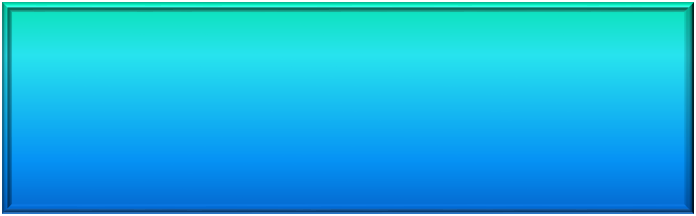
Thank You
Questions?
CMPP 257: Introduction to JavaScript & JQuery

